Slide 1
Robo Fencing with motion sensing camera
Vaibhav Kumar
Anand
Aman Raj
Yajas Menon

Slide 2
PROBLEM STATEMENT
Most injuries occur not only during normal operation but also during times when human interaction is most prevalent.
Programming , testing , inspection and repair by system design robots rarely need human interaction during normal use and operation which causes hazardous accidents to personnel.

Slide 3
SOLUTION
Types of sensors we have use are:
-> Sensor Pad
-> Heatmap
-> Light Sensor
->Camera Sensor

Slide 4
Sensor Pad
Advantages:
-> It will alert the system if any one touches the pad .
Disadvantages:
-> Costly
-> Cannot differentiate between humans and animals.
-> The foot may not touch the pad when the humans enter the cage.

Slide 5
Heat Sensor
Advantages:
-> Alerts the system and stops the robotic arm
Disadvantages:
-> Not applicable for 2 humans enetring the room , because it canges the bit from 0 to 1 when a person enter the room and again chnages that bit when other person enter the room and machine would again start moving.

Slide 6
Laser Sensor
Advantages:
-> This will alarm the robot whenever a human comes inside the cage
Disadvantages:
->Whenever a second person comes inside the cage the robot would start again

Slide 7
YoloV7
Advantages:
-> increased accuracy in predictions and a better Intersection over Union in bounding boxes (compared to real-time object detectors)
-> Captures 45 frames per second which is much better for accuracy.
Disadvantages:
-> Yolo model take time to train and take Input as video file which occupy good space of the system.

Slide 8
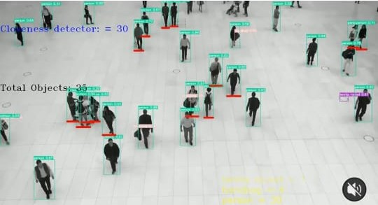
What we are using for our Problem Statement
YoloV7

Slide 9
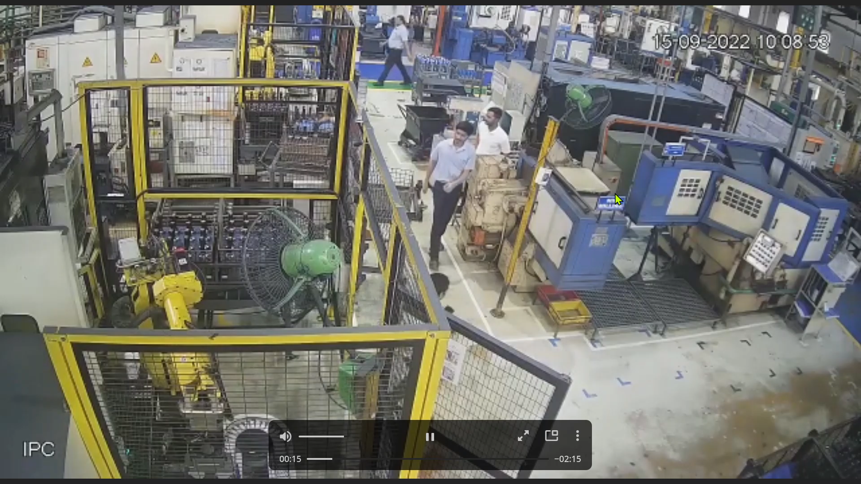
Machine on which we are applying YoloV7

Slide 10
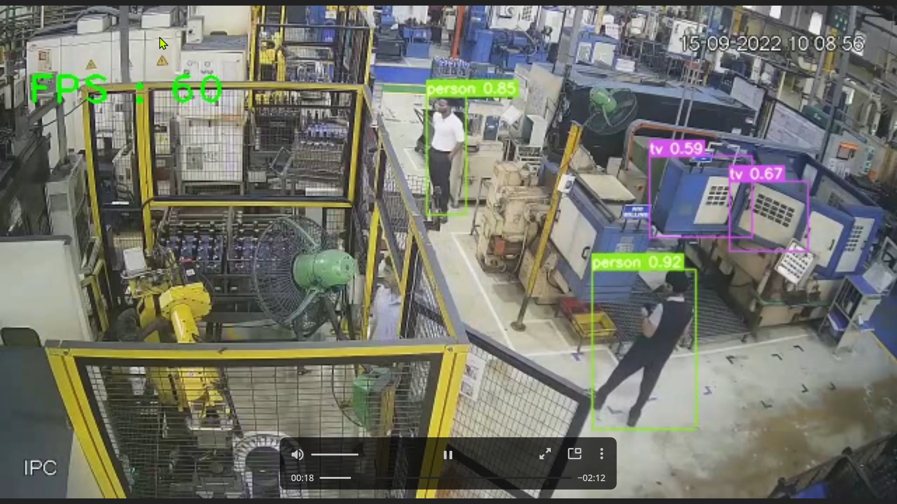
Comparison
Without implementation
After implementation

Slide 11
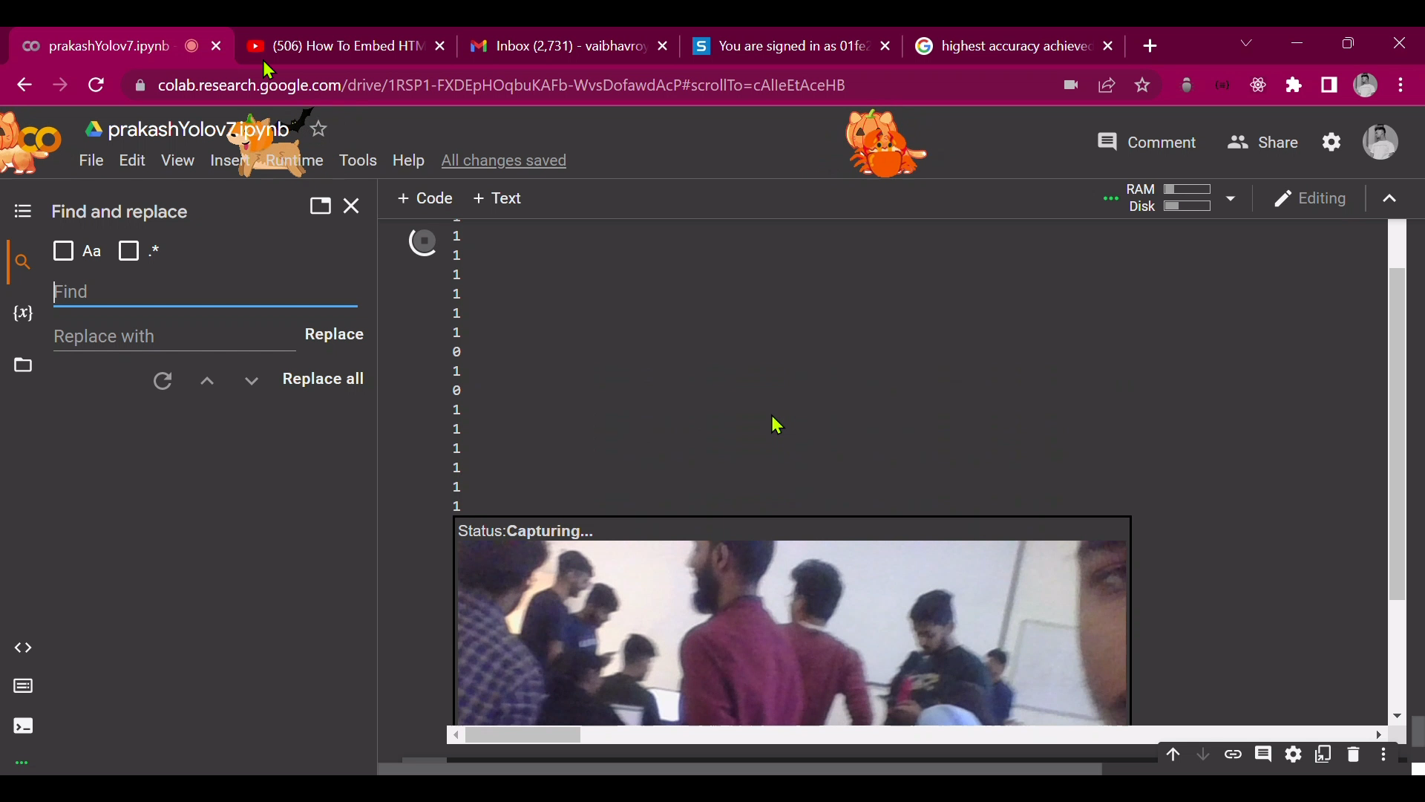
Output of our model
The model which we have implemented should work on live video that we capture from our camera . And it should give output based on that . If the camera detects any human the model gives output as 1 and the robot will stop working , and if there is no human detected the model will give output as 0

Slide 12
Thank You

